Slide 1
Machine Learning Project
Under supervisor:
Dr: Ali hamza
Eng: Ahmed Nousir

Slide 2
Title and Content
The objective of this study is to predict the Net Hourly Electrical Energy Output based on various input features such as Ambient Temperature (AT), Exhaust Vacuum (V), Ambient Pressure (AP), and Relative Humidity (RH). The dataset used for this analysis was obtained from [https://archive.ics.uci.edu/dataset/294/combined+cycle+power+plant].
Preprocessing
Build model and evaluation
Predict using models

Slide 3
Task One: Regression
First we search about data set and found one About Factors surrounding power plants affecting Net Hourly Electrical Energy Output
And we will try to predict this Output dependant on 4 element 'AT': 'Ambient Temperature'
'V’ : 'Exhaust Vacuum'
'AP': 'Ambient Pressure'
'RH': 'Relative Humidity’
And try to predict
'PE': 'Net Hourly Electrical Energy Output'

Slide 4
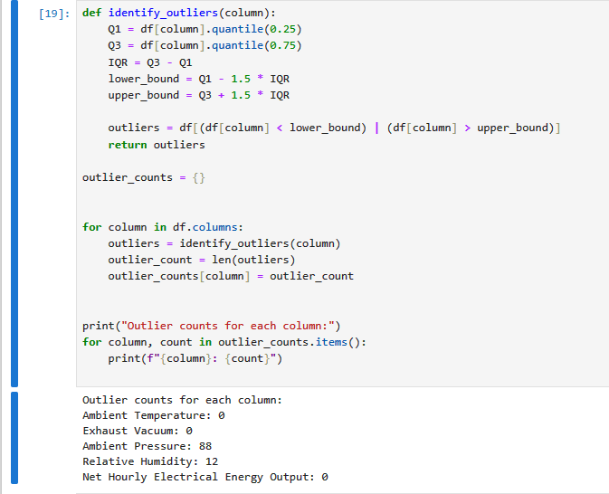
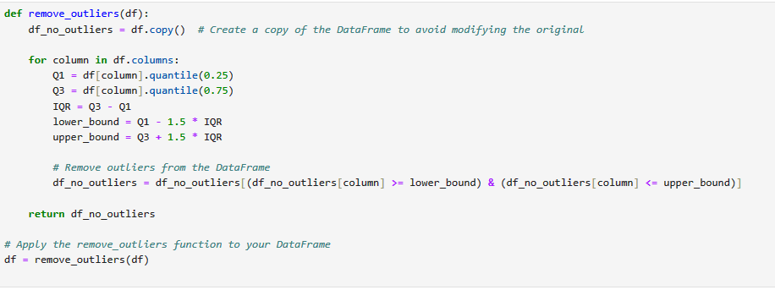
We count and remove outlier

Slide 5
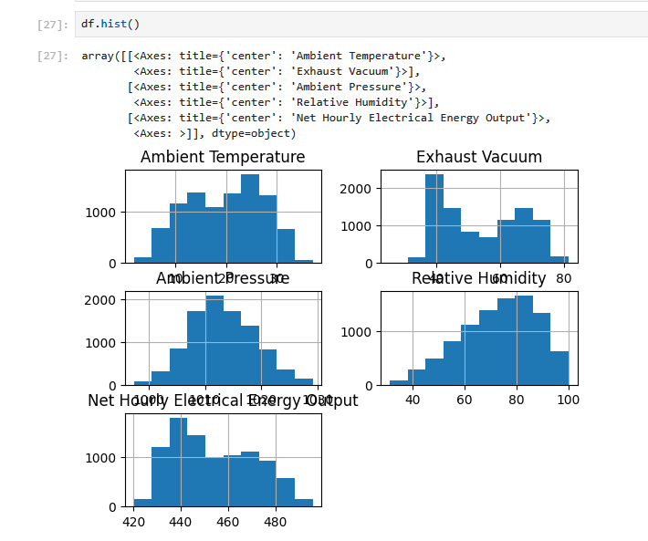
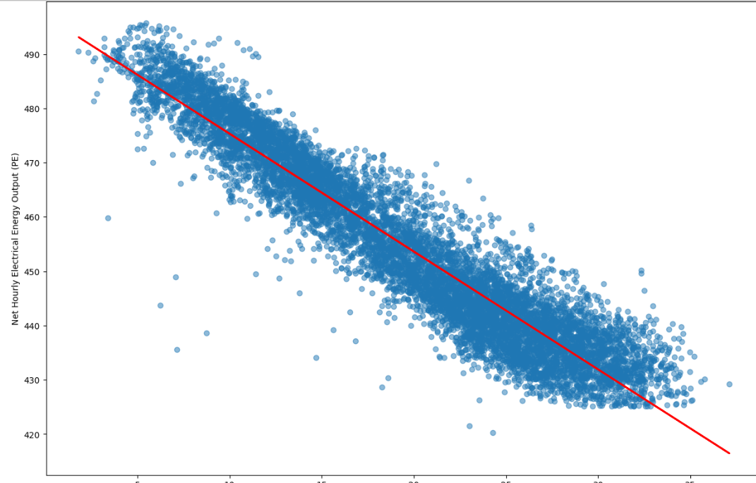
We start with reading dataset using pandas.read_cvs and make preprocessing to the data
Then visualize It see plots like frequency and relation between cols

Slide 6
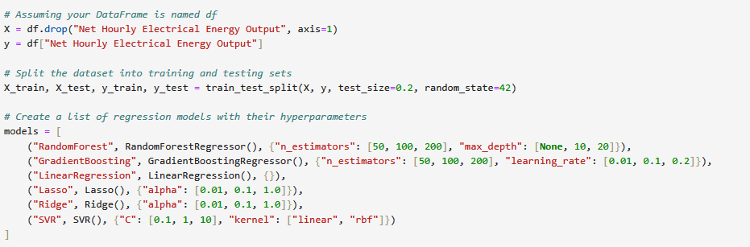
We start after this to select and define our model

Slide 7
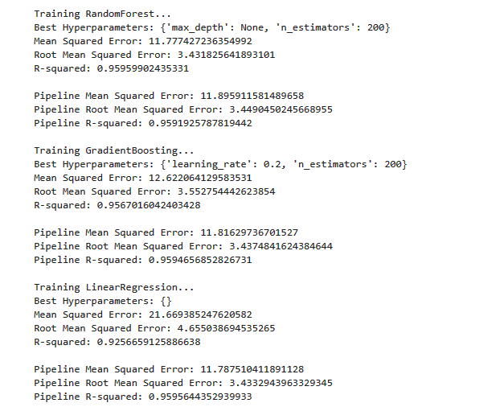
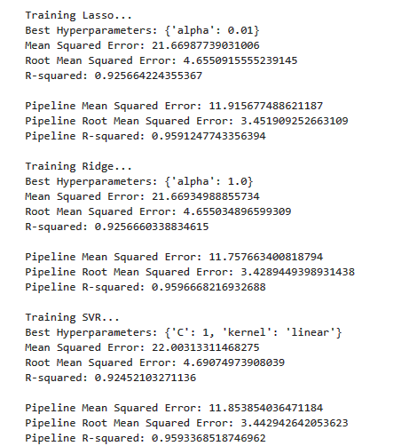
Output of traninig and changing parameters and evaluate the 6 model

Slide 8
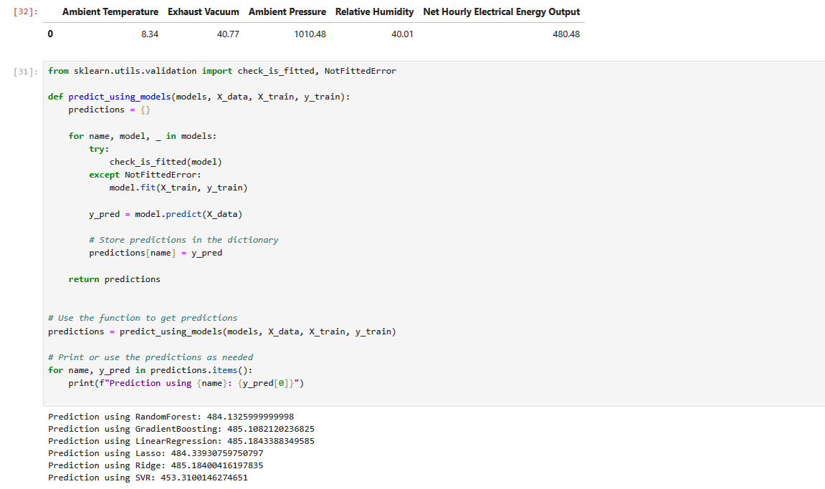
Output of prediction process and actual value

Slide 9
Title and Content
The Income Prediction project aims to develop machine learning models for predicting income based on various demographic and socioeconomic features. Accurate income prediction can have applications in financial planning, marketing strategies, and social research.
Preprocessing
Build model and evaluation
Predict using models

Slide 10
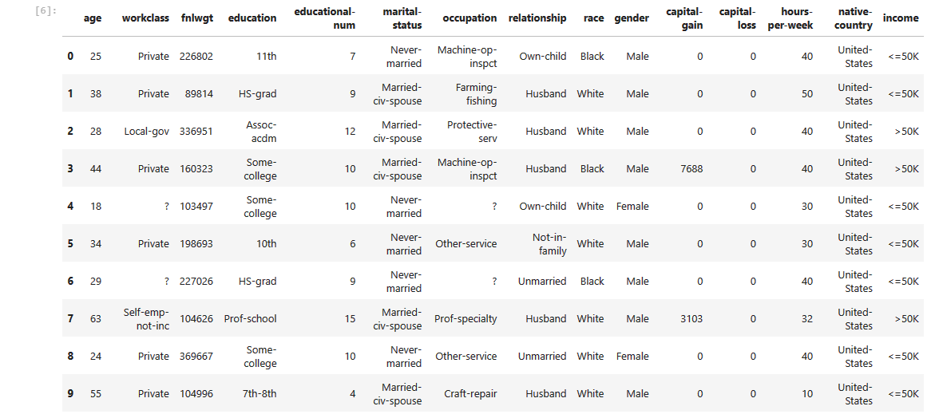
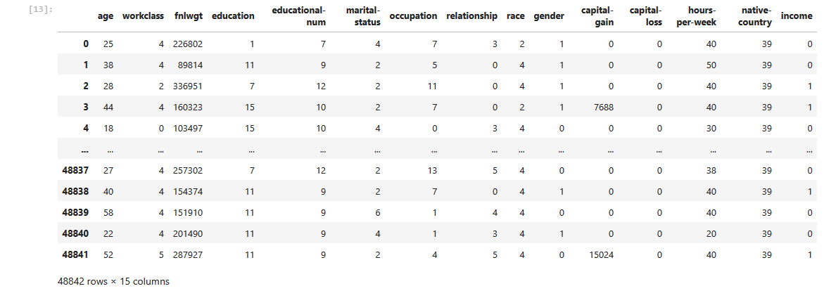
The primary problem addressed by this project is to predict whether an individual's income exceeds a certain threshold based on features such as age, education, occupation, and others. The problem is framed as a binary classification task, where the target variable is 'income' (<=50K or >50K).
Data before label encoder
Data after label encoder

Slide 11
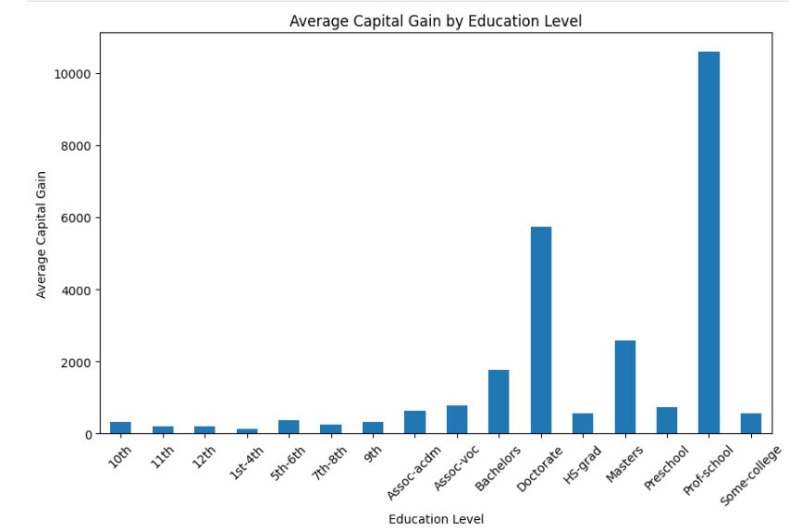
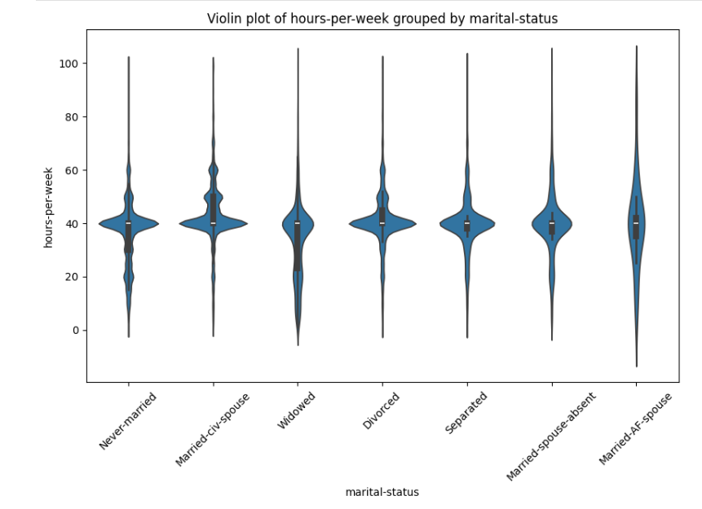
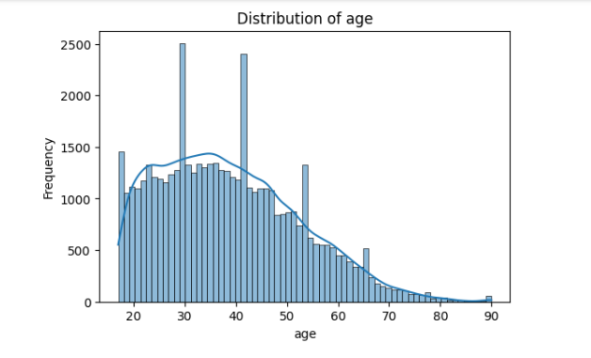

Slide 12
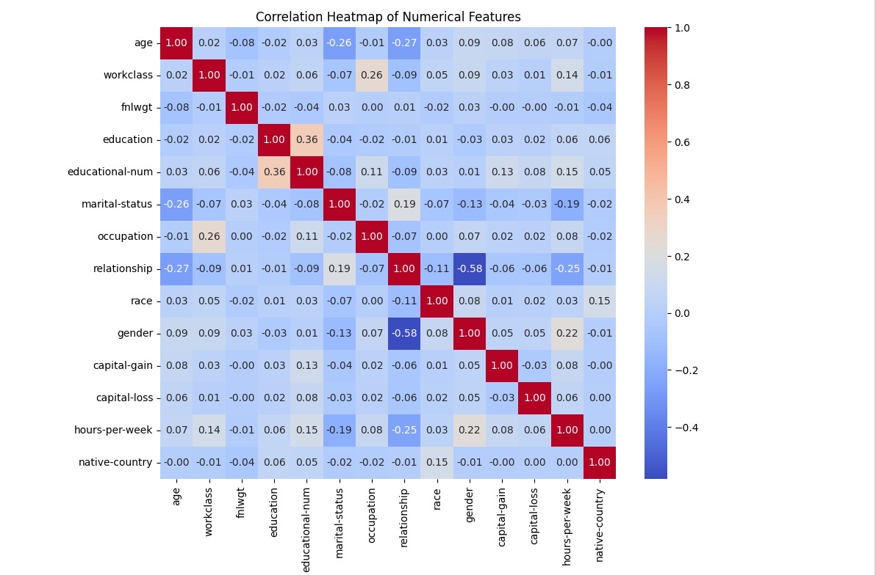

Slide 13
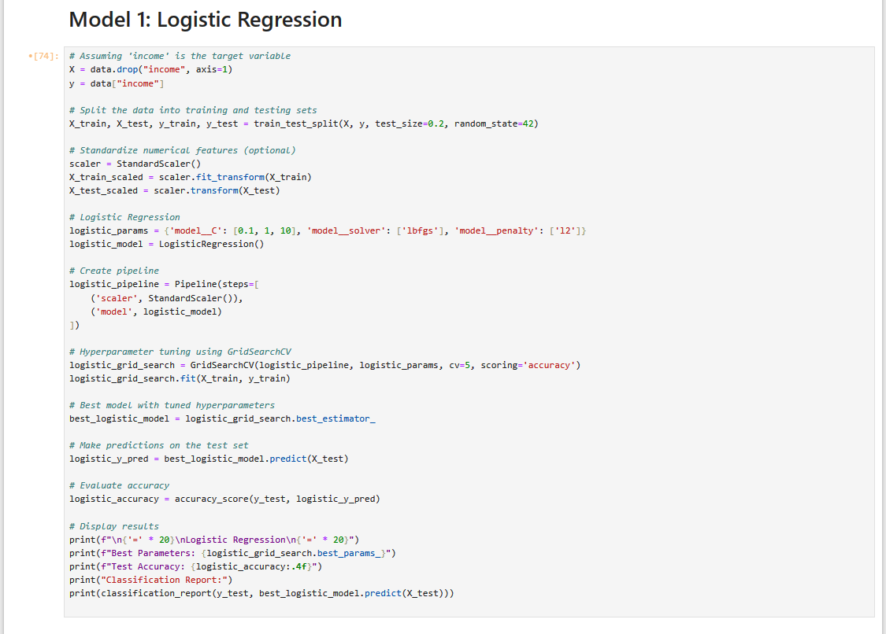
====================
Logistic Regression
====================
Best Parameters: {'model__C': 0.1, 'model__penalty’
: 'l2', 'model__solver': 'lbfgs'}
Test Accuracy: 0.8276
Classification Report:
precision recall f1-score support
0 0.85 0.94 0.89 7479
1 0.71 0.45 0.55 2290
accuracy 0.83 9769
macro avg 0.78 0.70 0.72 9769
weighted avg 0.82 0.83 0.81 9769

Slide 14
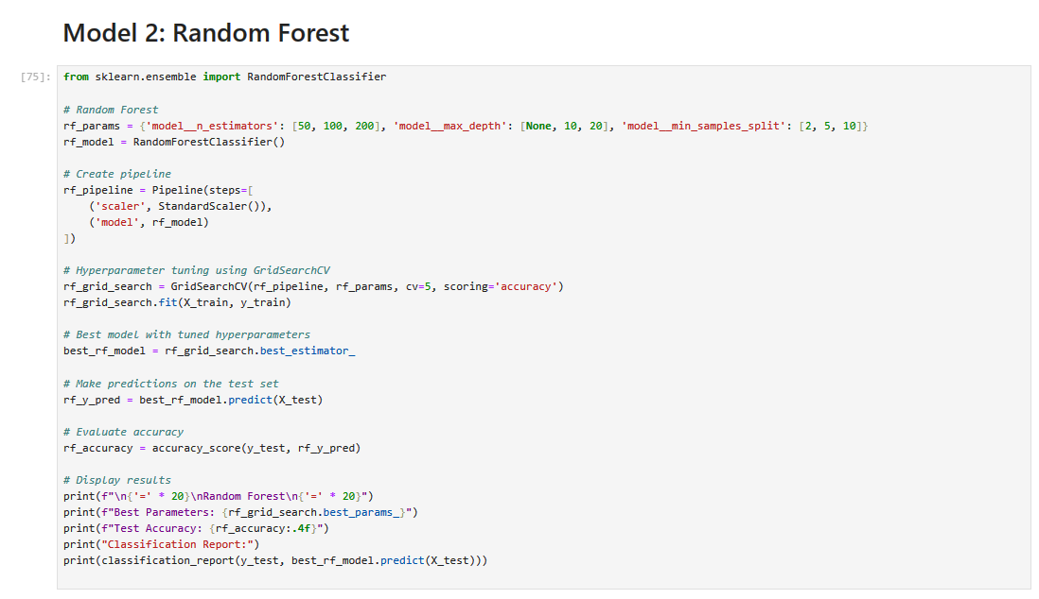
====================
Random Forest
====================
Best Parameters: {'model__max_depth': 20,
'model__min_samples_split': 10,
'model__n_estimators': 200}
Test Accuracy: 0.8720
Classification Report:
precision recall f1-score support
0 0.89 0.95 0.92 7479
1 0.78 0.63 0.70 2290
accuracy 0.87 9769
macro avg 0.84 0.79 0.81 9769
weighted avg 0.87 0.87 0.87 9769

Slide 15
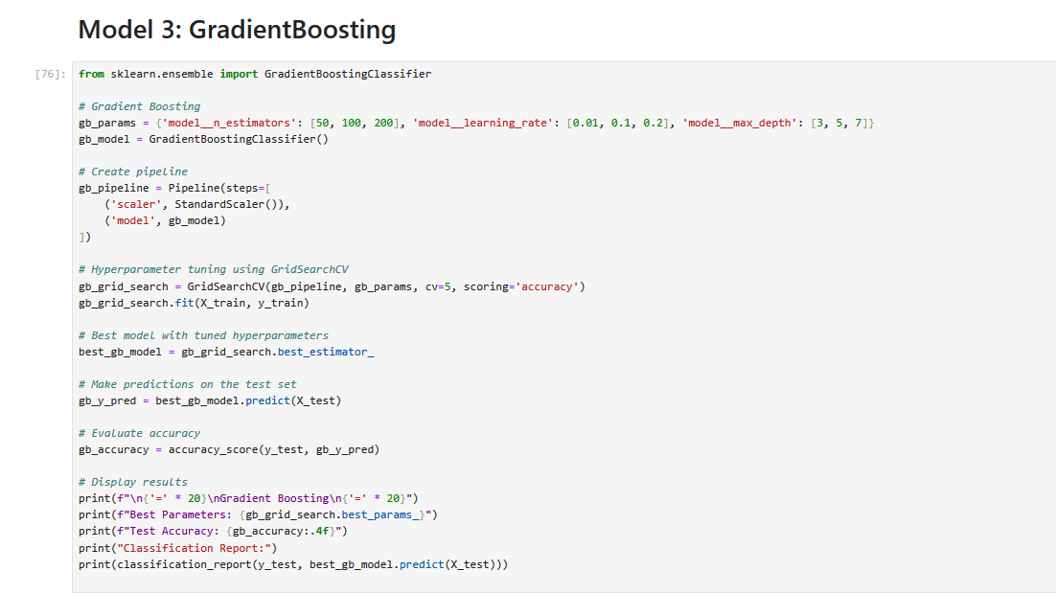
====================
Gradient Boosting
====================
Best Parameters: {'model__learning_rate': 0.1,
'model__max_depth': 5, 'model__n_estimators': 200}
Test Accuracy: 0.8795
Classification Report:
precision recall f1-score support
0 0.90 0.94 0.92 7479
1 0.78 0.67 0.72 2290
accuracy 0.88 9769
macro avg 0.84 0.81 0.82 9769
weighted avg 0.88 0.88 0.88 9769

Slide 16
Title and Content
The objective of this analysis is to cluster customers based on their demographic and socioeconomic attributes, such as age, gender, marital status, education, income, occupation, and settlement size. By grouping customers into clusters, we aim to identify patterns and segments within the customer base. This information can be valuable for targeted marketing, personalized services, and understanding customer behavior.
Preprocessing
Build model and evaluation
Predict using models

Slide 17
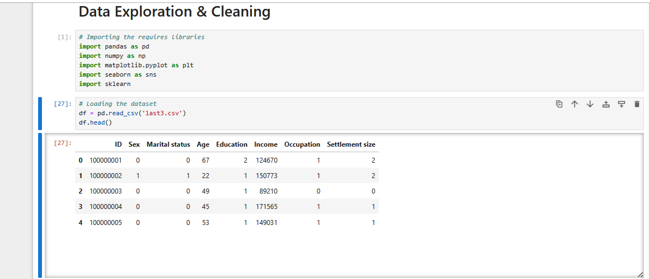

Slide 18
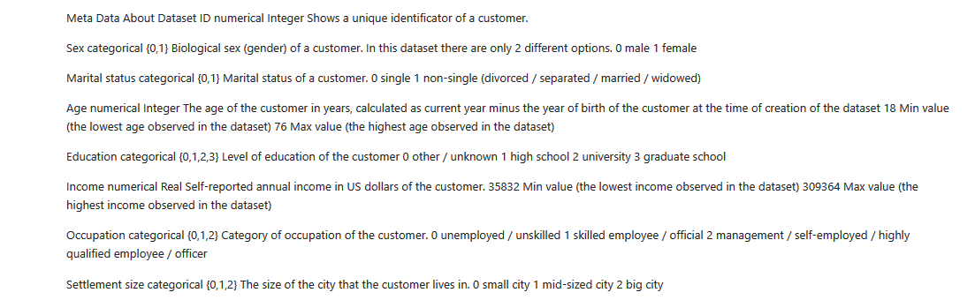
What Data is about

Slide 19
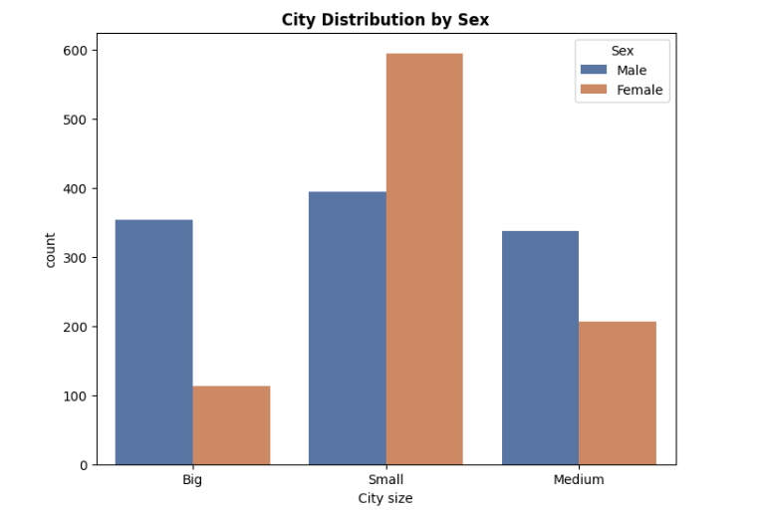
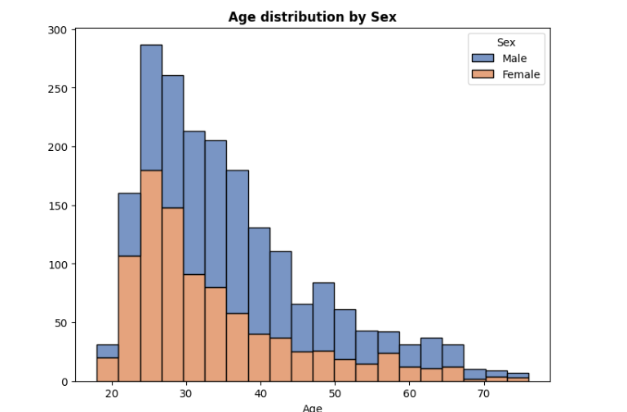
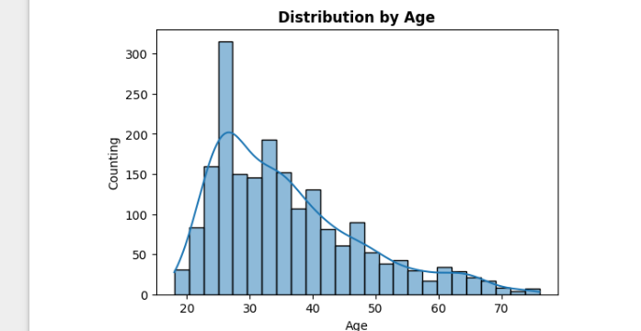
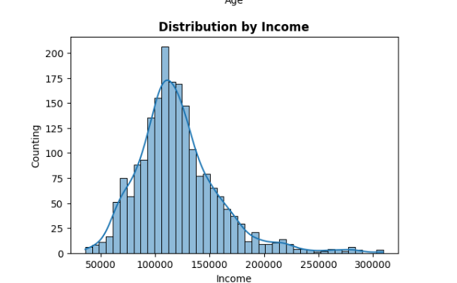

Slide 20
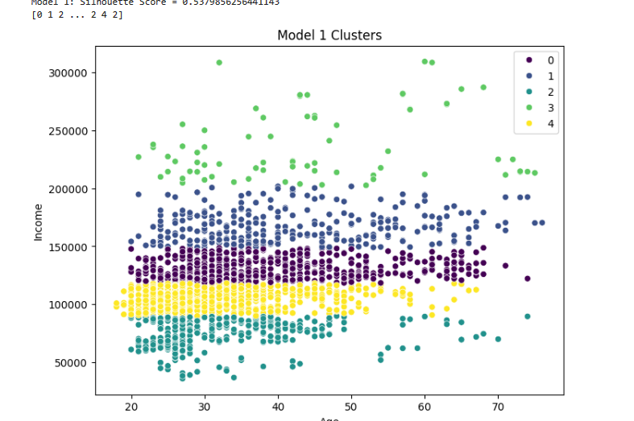
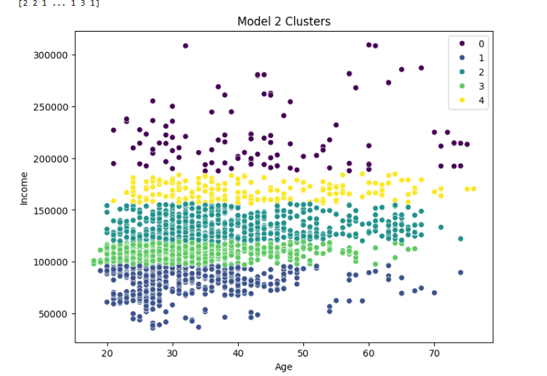
Output of Clusters model

Slide 21
Title and Content
The Income Prediction project aims to develop machine learning models for predicting income based on various demographic and socioeconomic features. Accurate income prediction can have applications in financial planning, marketing strategies, and social research.
Preprocessing
Build model and evaluation
Predict using models

Slide 22
In dataset we have 4 categ:
- glioma
-meningioma
- no tumor
- pituitary
We will classifiy the input image to one of them using CNN

Slide 23
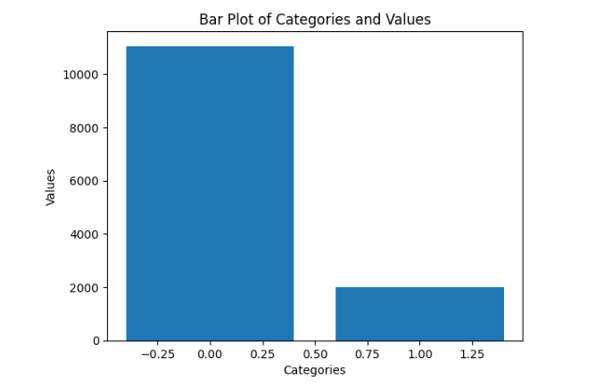
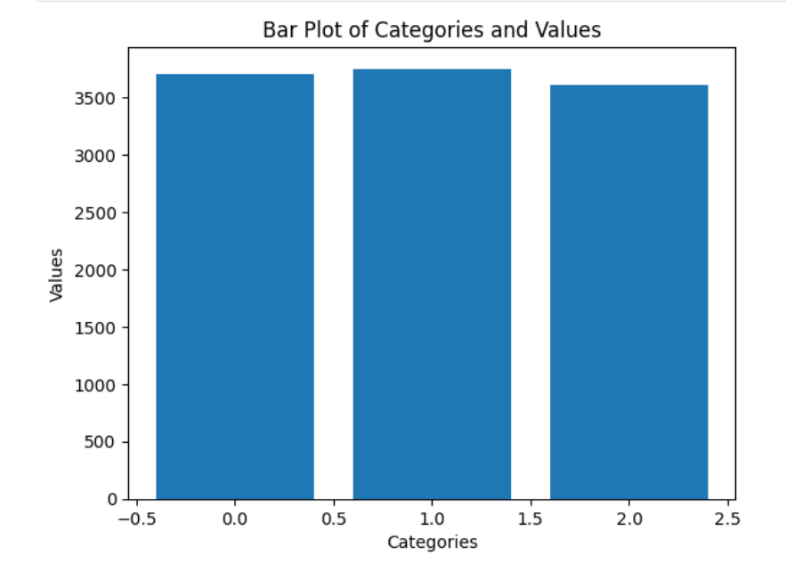
The Key Of hiegh Accurcy
El-Baba

